Slide 1
OpenStack QA
Nov 2018
Project Update, OpenStack Summit Berlin
Ghanshyam Mann,
IRC- gmann, gmann@ghanshyammann.com

Slide 2

Notes:
Insert Mascot right

Slide 3

What is OpenStack QA??
Official Mission Statement:
“Develop, maintain, and initiate tools and plans to ensure the upstream stability and quality of OpenStack, and its release readiness at any point during the release cycle.”
Notes:
Insert Mascot right

Slide 4
What is OpenStack QA??
Tempest
Devstack
Patrole
Grenade
devstack-tools
devstack-plugin-ceph
devstack-plugin-container
openstack-health
os-testr
Stackviz
bashate
coverage2sql
eslint-config-openstack
os-performance-tools
devstack-vagrant
devstack-plugin-cookiecutter
karma-subunit-reporter
tempest-plugin-cookiecutter
tempest-lib (Deprecated)
Hacking
tempest-stress
https://governance.openstack.org/tc/reference/projects/quality-assurance.html
Notes:
Insert Mascot right

Slide 5
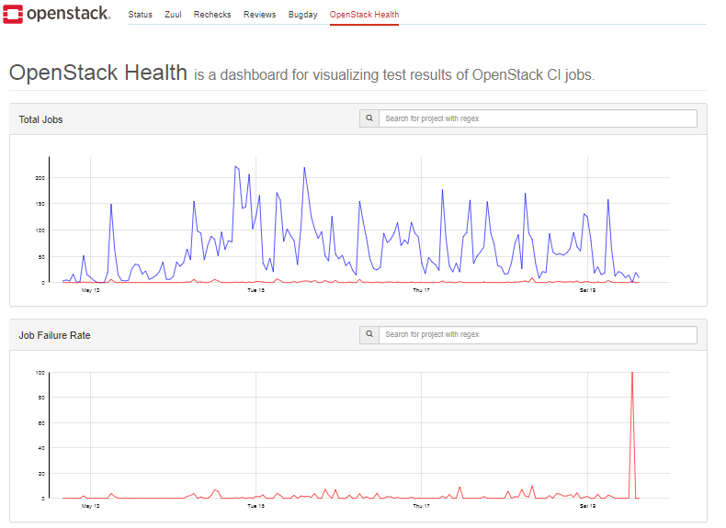
What is OpenStack QA??
Things we do:
Community driven approach to QA
Serve the OpenStack community
Drive testing best practices
Maintain test tools and frameworks
Keep the gate running smoothly
Support interoperability testing efforts
Cross Community collaboration on testing tools etc
Open for new testing ideas/projects
Notes:
Insert Mascot right

Slide 6

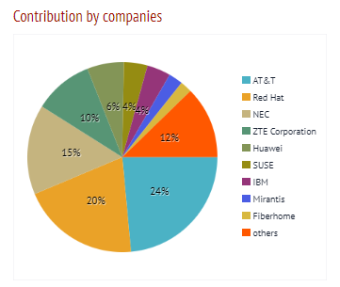
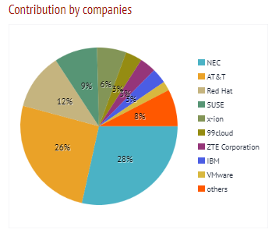

QA CONTRIBUTION STATS: (Rocky Cycle)
2 new cores in Patrole
http://stackalytics.com/?metric=marks&release=rocky&module=quality%20assurance-group
Commits: Total 497 (Queens- 661) Reviews: Total 2159 (Queens-2660) Bugs
Current Open Requests:
Filed Bugs: 87
Resolve Bugs: 58
Notes:
Insert Mascot right

Slide 7
OpenStack Rocky Features
Zuul v3 native base jobs
Devstack Jobs
Tempest jobs
Grenade jobs (In progress)
Testing the latest APIs
Volume testing default to v3
API Microversion testing
Kolla’s Tempest & Plugins container source image
More coverage for new features and API in Tempest & Devstack

Slide 8
OpenStack Rocky Features
Patrole:
All Stable branch testing in Patrole gate
Starting the neutron test coverage.
Multi policy testing support
Misc updates for stable release of Patrole job.

Slide 9
OpenStack Stein
Finish Zuul v3 native jobs for grenade
Patrole stable release
More documentation and guidelines for Tempest plugins
Consuming all Tempest CLI in gate
Make scenario manager stable for plugins
Tempest smart cleanup feature
Volume strict validation testing using JSON schema
Keystone system scope testing support in Tempest & Devstack along with gate job setup
New initiative:
Proposal for New QA project: Harbinger
Responsibility of supporting the OpenStack CI/CD platform updates
Migration of gate jobs to new Distribution
Image updates

Slide 10
Beyond Stein
Extreme testing (HA, fault management etc)
Proposal for New QA project: Harbinger
RBAC testing on gate using Patrole

Slide 11
Cross-Project Work
Zuulv3 migration from base jobs
Plugins help on fixing the usage and guidelines
Support the OpenStack CI/CD platform updates

Slide 12
How to give feedback
Report Bug
Bug Tracking links - https://wiki.openstack.org/wiki/QA
Send mail on ML: openstack-dev@lists.openstack.org with [qa] in subject
openstack-discuss@lists.openstack.org active from Nov 19th 2018.
Ping on IRC.
Catch us in PTG.
Forum session:
Users / Operators Feedback on QA
QA Onboarding sessions

Slide 13
How to contribute
TODAY: QA Onboarding sessions, Tuesday, November 13, 5:10pm-5:50pm CityCube Berlin - Level 3 - M-Räum 1
Join us in #openstack-qa, Freenode IRC.
PTG: OpenStack QA Room @PTG May 2-4, 2019
OpenStack Contributor Guide.

Slide 14
Q&A
Thank you!
openstack
openstack
OpenStackFoundation

